Slide 1
Tower Wood Residential
Tuesday 23rd November 2021 – Friday 26th November 2021

Slide 2
The Area
Location | Average Temperature | Average Warm Temp | Average Cold Temp
Windermere (Nov) | 5.7 | 9.1 | 2.4
Barnsley (Nov) | 5.4 | 8.0 | 2.7
The weather in the Lake District valley bottoms is generally warm, becoming colder on high peaks (which we won’t be going up).

Slide 3
Medication
If your child requires any medication, a medical form must be completed as soon as possible, and the relevant dosages in school no later than Friday 5th November. This includes paracetamol, travel sickness tablets, inhalers and prescribed medication. There are two forms, one for items such as inhalers which your child uses themselves, and one for any medication that a member of staff needs to give.
Their medicine should be handed to Mr Jewitt or Mrs Bailey in a sealed bag, with their name on and all times/dosages.

Slide 4
What to Pack
See kit list
Optional Extras
Disposable camera(s)
Sweets/snacks for the journey
Magazines/books

Slide 5
Departure
We will leave school at 7:30am.
Please ensure your child is in school no later than 7:10am.
You are more than welcome to stay and wave them off.

Slide 6
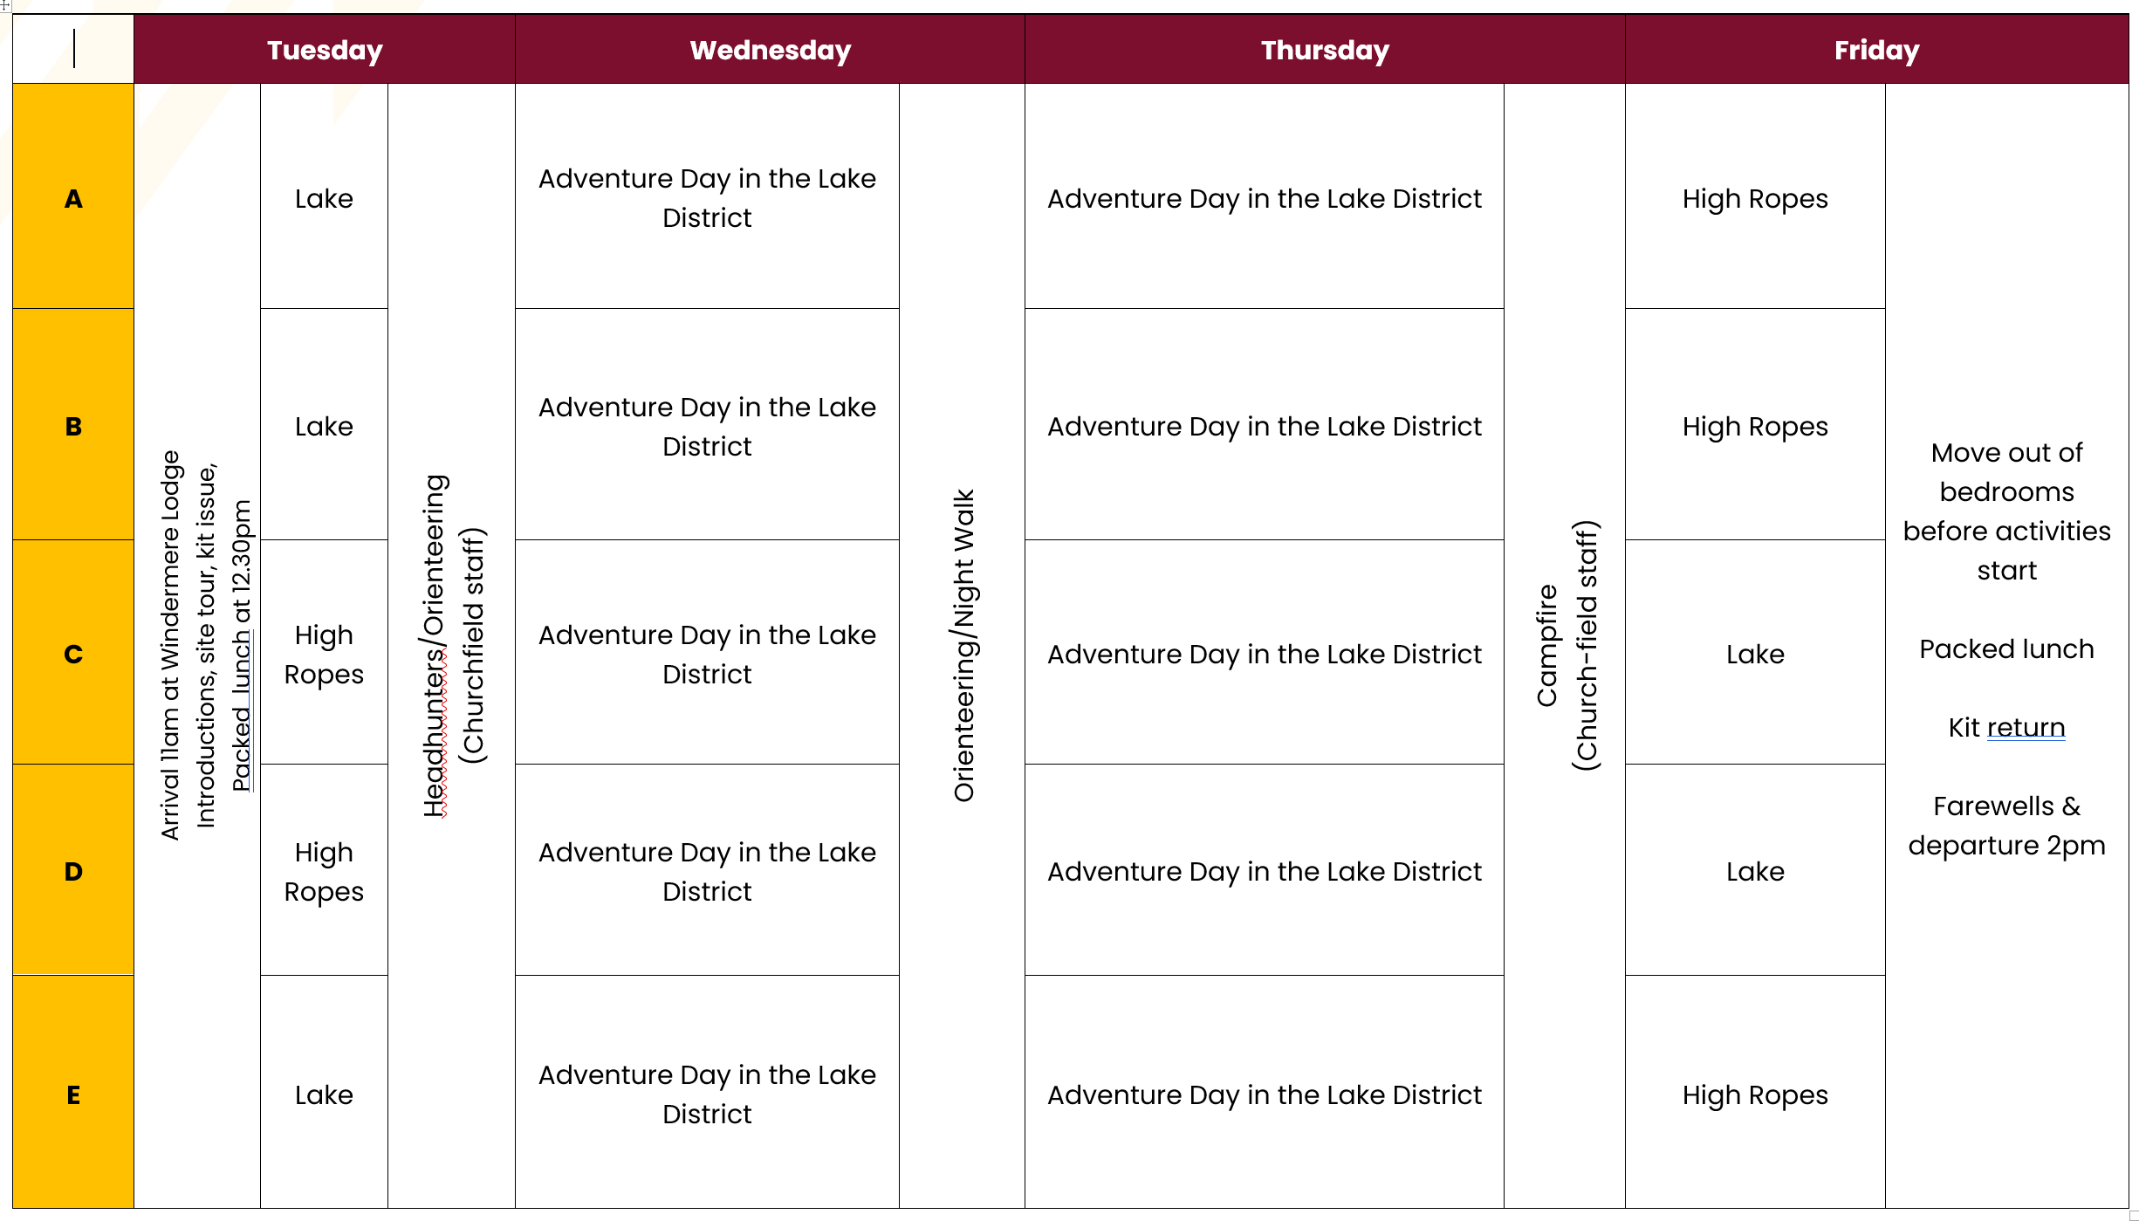
The Programme

Slide 7
Rules
All school rules still apply and children are expected to keep up the same high standards of behaviour that they show here.
No electrical items (e.g. phones, tablets, games consoles)
Please do not send children with digital cameras as they are expensive if lost, and have the potential to be dropped in the lake. However, we do strongly recommend that they bring a disposable camera(s).
A small amount of sweets and snacks are allowed for the journey – but at your discretion. Please do not send children with too many. They may wish to take some on the bus for the journey.
Magazines and books are highly recommended for the journey.
Once in their own rooms at ‘lights out’, they must stay in their own rooms unless there is an emergency or any issues.
They don’t need any spending money.

Slide 8
Food
This is an example menu.
All food is prepared fresh on-site by kitchen staff.
Menu
Day 1 | Day 2 | Day 3
Breakfast | Breakfast | Breakfast
 | Cereals, Sausage, Bacon, Tomato, Hash Brown, Toast, Tea and Juice | Cereals, Sausage, Bacon, Tomato, Hash Brown, Toast, Tea and Juice
Lunch | Lunch | Lunch
Packed lunch (sent from home) | Packed Lunches (made at centre) | Packed Lunches (made at centre)
Tea | Tea | Tea
Mild Chilli con Carne & Rice Hot Apple Pie & Ice Cream | Chicken Pie with Gravy, Chips, Peas & Carrots Chocolate Fudge Cake & Whipped Cream
Supper | Supper | Supper
Oat Biscuits & Drinks | Oat Biscuits & Drinks

Slide 9
Extra Information
No aerosols!
A member of staff will regularly phone/text school with updates and information. The office will then send this information to you via text. Please make sure the office has your up to date number.
‘Lights out’ will be approximately 10:00pm, but children will be allowed time before hand to relax and prepare for bed.
Members of staff will be available at all times.
On the morning we leave, please make sure their luggage is in the hall with their name clearly labelled. We ask for all children to be at school for about 7:15/7:20am and parents are more than welcome to stay and wave them off.
Residential are about promoting independence, children enjoying themselves and having a fantastic experience that they will never forget!
Follow the school’s Twitter account – strongly recommended

Slide 10
Extra Information
There are no phones/tablets/electronic devices allowed. School will text parents regularly to update you. Please make sure the office has your current number.
Medical forms need to be in ASAP.
Please let us know about any allergies/conditions too. For any sensitive matters that you wish to discuss in private, please just speak to a member of staff. We need to know everything.
If you have any questions at all, just ask.
Children will not need any spending money.

Slide 11
Medical Forms
In order for your child to attend there are compulsory medical forms from Lancashire Country Council that need to be completed. There is also a register form available, please write your child’s address and complete the medical section and dietary requirements section. The age is their age when we are on the trip. This must be completed and returned either tonight or no later than Friday 15th October. The medical forms that need to be completed are the same form that you would complete for any residential or trip that is outdoors whether that be Kingswood, the Lake District or elsewhere.
Ideally these need to be completed tonight, however, if you are in a rush please finish at home and bring it back to school after half term.

Slide 12
Tips
Do’s and Don’ts
Do | Don’t
Get along with each other Have fun and enjoy yourself Ask questions about the places we are going Listen when an adult is speaking Always stay with the group Use your manners Respect all people we meet | Stop others from sleeping Mess around in rooms Fall out with people Be rude to any other children or adults Share medicine with anyone Leave your room after lights out, unless it is an emergency

Slide 13
Before You Go
Make sure you have signed in
Completed the register form
Completed the medical form
Asked any questions!

Slide 14
